Slide 1
https://youtu.be/h4MhbkWJzKk

Slide 2
Applied Statistical Analysis
EDUC 6050
Week 7
Finding clarity using data

Slide 3
Today
Hypothesis Testing with ANOVA
Review for Exam
Chapters 11 and 12 in Book

Slide 10
ANalysis Of VAriance
It is a whole class of methods
Generally used with experimental designs
Has similar assumptions to t-test
Gives an “omnibus” result
 | Sum of Squares | df | Mean Square | F | p
Children | 26.8 | 3 | 8.92 | 2.38 | .087
Residuals | 127.5 | 34 | 3.75

Slide 11
The F statistic
Notes:
F goes from 0 to positive infinite
Is based on two different degrees of freedom
Only one tail

Slide 12
There are several types

Slide 13
General
Requirements
ID | Outcome | Group
1 | 8 | 1
2 | 8 | 1
3 | 9 | 1
4 | 7 | 1
5 | 7 | 2
6 | 9 | 2
7 | 5 | 2
8 | 5 | 2
Need a DV on an interval/ratio scale,
IV defines 2+ different groups (or time points)

Slide 14
General
Requirements
ID | Time 1 | Time 2
1 | 8 | 7
2 | 8 | 8
3 | 9 | 6
4 | 7 | 6
5 | 7 | 8
6 | 9 | 5
7 | 5 | 3
8 | 5 | 3
Need a DV on an interval/ratio scale,
IV defines 2+ different groups (or time points)

Slide 15
Hypothesis Testing with ANOVA
The same 6 step approach!
Examine Variables to Assess Statistical Assumptions
State the Null and Research Hypotheses (symbolically and verbally)
Define Critical Regions
Compute the Test Statistic
Compute an Effect Size and Describe it
Interpreting the results

Slide 16
Examine Variables to Assess Statistical Assumptions
1
Basic Assumptions
Independence of data
Appropriate measurement of variables for the analysis
Normality of distributions
Homogeneity of variance

Slide 17
Examine Variables to Assess Statistical Assumptions
1
Basic Assumptions
Independence of data
Appropriate measurement of variables for the analysis
Normality of distributions
Homogeneity of variance
Individuals are independent of each other (one person’s scores does not affect another’s)

Slide 18
Examine Variables to Assess Statistical Assumptions
1
Basic Assumptions
Independence of data
Appropriate measurement of variables for the analysis
Normality of distributions
Homogeneity of variance
Here we need interval/ratio DV
Notes:
For F-test, DV needs to be interval/ratio

Slide 19
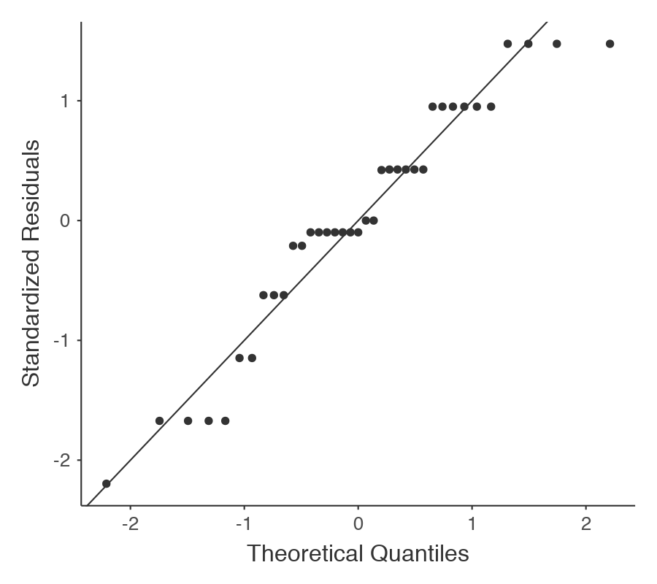
Examine Variables to Assess Statistical Assumptions
1
Basic Assumptions
Normality of the residuals
Independence of data
Appropriate measurement of variables for the analysis
Normality of distributions
Homogeneity of variance

Slide 20
Examine Variables to Assess Statistical Assumptions
1
F | df1 | df2 | P
2.86 | 3 | 34 | .051
Basic Assumptions
Independence of data
Appropriate measurement of variables for the analysis
Normality of distributions
Homogeneity of variance
The variances of groups should be equal (not strict if each group has similar sample sizes)

Slide 21
Examine Variables to Assess Statistical Assumptions
1
Examining the Basic Assumptions
Independence: random sample
Appropriate measurement: know what your variables are
Normality: Histograms, Q-Q, skew and kurtosis
Homogeneity: Levene’s Test

Slide 22
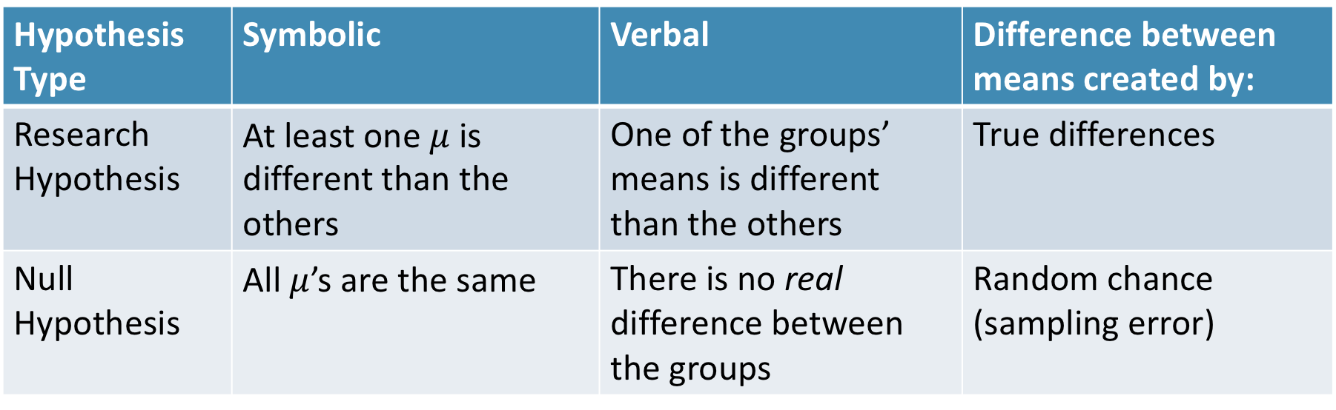
State the Null and Research Hypotheses (symbolically and verbally)
2
Hypothesis Type | Symbolic | Verbal | Difference between means created by:
Research Hypothesis | At least one $μ$ is different than the others | One of the groups’ means is different than the others | True differences
Null Hypothesis | All $μ$’s are the same | There is no real difference between the groups | Random chance (sampling error)
Notes:
Null and research hypotheses are mutually exclusive (they cover all possible outcomes)

Slide 23
Define Critical Regions
3
How much evidence is enough to believe the null is not true?
Before analyzing the data, we define the critical regions (generally based on an alpha = .05)

Slide 24
Define Critical Regions
3
We decide on an alpha level first
Then calculate the critical value (based on sample size)

Slide 25
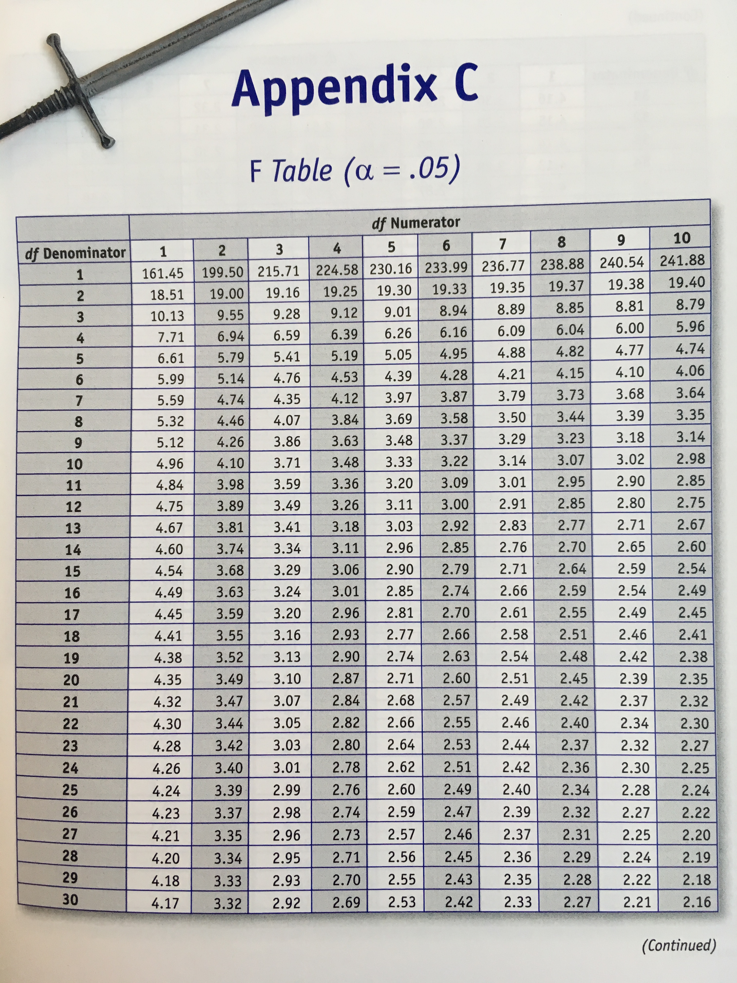


Define Critical Regions
3
We decide on an alpha level first
Then calculate the critical value (based on sample size)
Use the table in the book
Base on alpha and 2 specific df’s
$df_{num}=g −1$ where g is number of groups
$df_{den}=N −g$
Notes:
$df_{num}$ is also knowns as $df_{between}$
$df_{den}$ is also knowns as $df_{within}$ or $df_{error}$ or $df_{residual}$

Slide 26


Define Critical Regions
3
We decide on an alpha level first
Then calculate the critical value (based on sample size)
$$F_{critical}\left(2, 29\right)=3.33$$
So our critical region is defined as:
$$α= .05$$
$$F_{critical}\left(2, 29\right)=3.33$$
Notes:
If our computed t value is beyond 2.05 OR our p-value is below .05, then we REJECT the null (the findings are statistically significant)

Slide 27
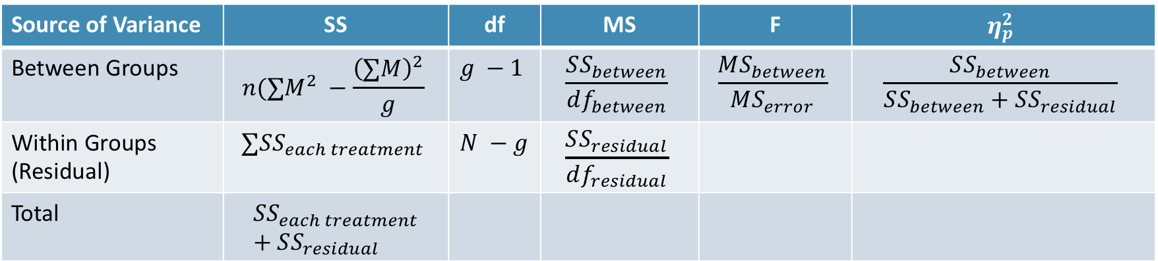
Compute the Test Statistic
4
Source of Variance | SS | df | MS | F | $$η_{p}^{2}$$
Between Groups | $$n(∑M^{2} −\frac{{\left(∑M\right)}^{2}}{g}$$ | $$g −1$$ | $$\frac{SS_{between}}{df_{between}}$$ | $$\frac{MS_{between}}{MS_{error}}$$ | $$\frac{SS_{between}}{SS_{between}+SS_{residual}}$$
Within Groups (Residual) | $$∑SS_{each treatment}$$ | $$N −g$$ | $$\frac{SS_{residual}}{df_{residual}}$$
Total | $$SS_{each treatment}+SS_{residual}$$

Slide 28
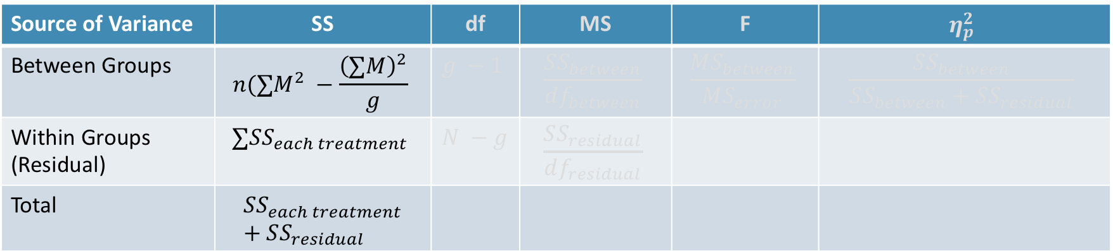
Compute the Test Statistic
4
“Sum of Squares” – adding up all the squared deviations (essentially like SD)
Source of Variance | SS | df | MS | F | $$η_{p}^{2}$$
Between Groups | $$n(∑M^{2} −\frac{{\left(∑M\right)}^{2}}{g}$$ | $$g −1$$ | $$\frac{SS_{between}}{df_{between}}$$ | $$\frac{MS_{between}}{MS_{error}}$$ | $$\frac{SS_{between}}{SS_{between}+SS_{residual}}$$
Within Groups (Residual) | $$∑SS_{each treatment}$$ | $$N −g$$ | $$\frac{SS_{residual}}{df_{residual}}$$
Total | $$SS_{each treatment}+SS_{residual}$$
Gets split by where the variation is coming from
Between the groups (the differences in the groups)
Within the groups

Slide 29
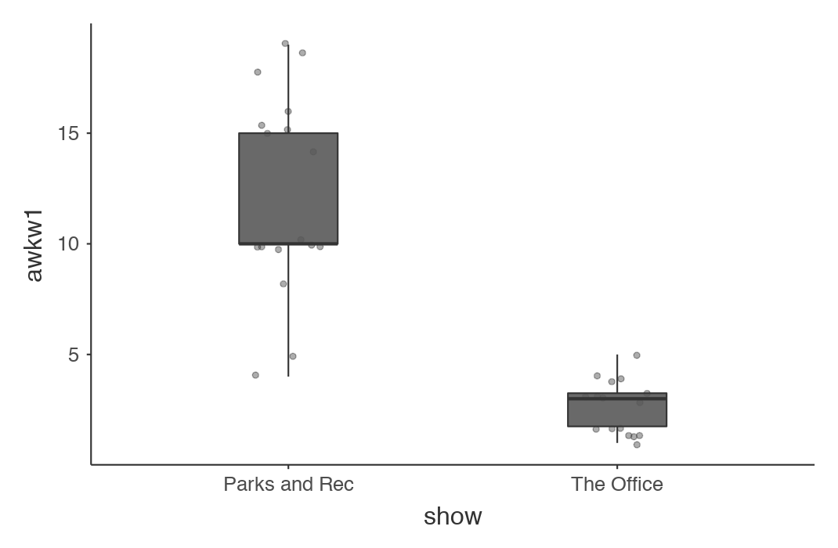
Compute the Test Statistic
4
Within group variation (residual)
Outcome
Within group variation (residual)

Slide 30
Compute the Test Statistic
4
Outcome
Between Groups variation

Slide 31
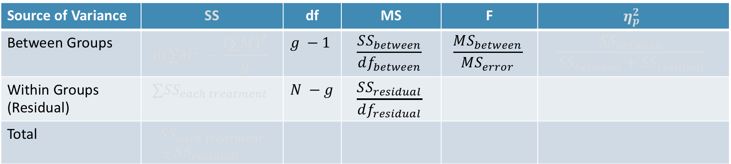
Compute the Test Statistic
4
Source of Variance | SS | df | MS | F | $$η_{p}^{2}$$
Between Groups | $$n(∑M^{2} −\frac{{\left(∑M\right)}^{2}}{g}$$ | $$g −1$$ | $$\frac{SS_{between}}{df_{between}}$$ | $$\frac{MS_{between}}{MS_{error}}$$ | $$\frac{SS_{between}}{SS_{between}+SS_{residual}}$$
Within Groups (Residual) | $$∑SS_{each treatment}$$ | $$N −g$$ | $$\frac{SS_{residual}}{df_{residual}}$$
Total | $$SS_{each treatment}+SS_{residual}$$
Is the amount of difference in the means big compared to how much variability there is in the groups?
These are all ratios
Answers

Slide 32
Compute the Test Statistic
4
F-statistic and p-value tell you if one of the groups is different than the others
Post Hoc Tests
But it doesn’t tell you which ones are different...

Slide 33
Compute the Test Statistic
4
Post Hoc Tests
(or Contrasts)
Post hoc usually refers to comparing all groups with each other (and making an adjustment for the multiple comparisons)
Contrasts usually refers to comparing some of the groups with each other (or a combination of groups with each other)

Slide 34
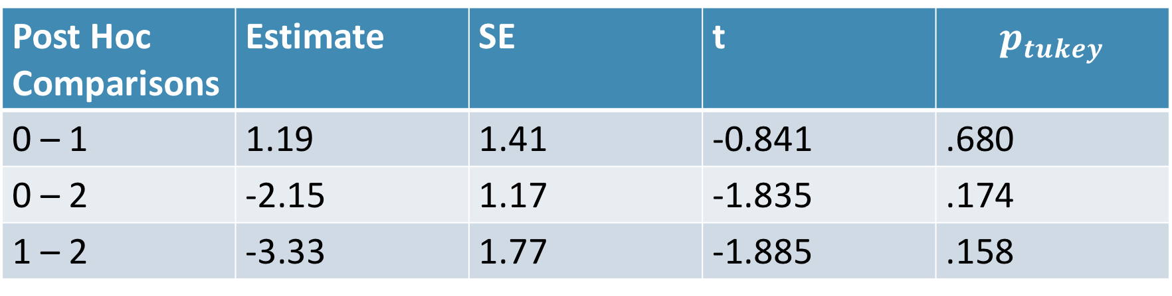
Compute the Test Statistic
4
Post Hoc Tests (or Contrasts)
Contrasts | Estimate | SE | t | p
1 – 0 | -1.19 | 1.41 | -0.841 | .406
1 – 0 | 2.15 | 1.17 | 1.835 | .075
Post Hoc Comparisons | Estimate | SE | t | $$p_{tukey}$$
0 – 1 | 1.19 | 1.41 | -0.841 | .680
0 – 2 | -2.15 | 1.17 | -1.835 | .174
1 – 2 | -3.33 | 1.77 | -1.885 | .158

Slide 35
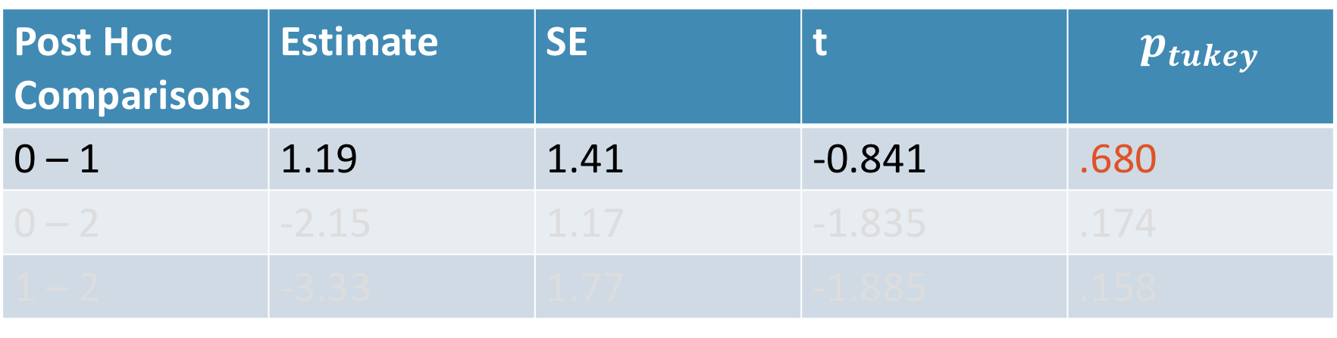
Compute the Test Statistic
4
Post Hoc Tests (or Contrasts)
Contrasts | Estimate | SE | t | p
1 – 0 | -1.19 | 1.41 | -0.841 | .406
1 – 0 | 2.15 | 1.17 | 1.835 | .075
Post Hoc Comparisons | Estimate | SE | t | $$p_{tukey}$$
0 – 1 | 1.19 | 1.41 | -0.841 | .680
0 – 2 | -2.15 | 1.17 | -1.835 | .174
1 – 2 | -3.33 | 1.77 | -1.885 | .158

Slide 36
Compute the Test Statistic
4
Source of Variance | SS | df | MS | F | $$η_{p}^{2}$$
Between Groups | $$n(∑M^{2} −\frac{{\left(∑M\right)}^{2}}{g}$$ | $$g −1$$ | $$\frac{SS_{between}}{df_{between}}$$ | $$\frac{MS_{between}}{MS_{error}}$$ | $$\frac{SS_{between}}{SS_{between}+SS_{residual}}$$
Within Groups (Residual) | $$∑SS_{each treatment}$$ | $$N −g$$ | $$\frac{SS_{residual}}{df_{residual}}$$
Total | $$SS_{each treatment}+SS_{residual}$$
Answers
How much of the variability is accounted for by the groups vs everything else?

Slide 37

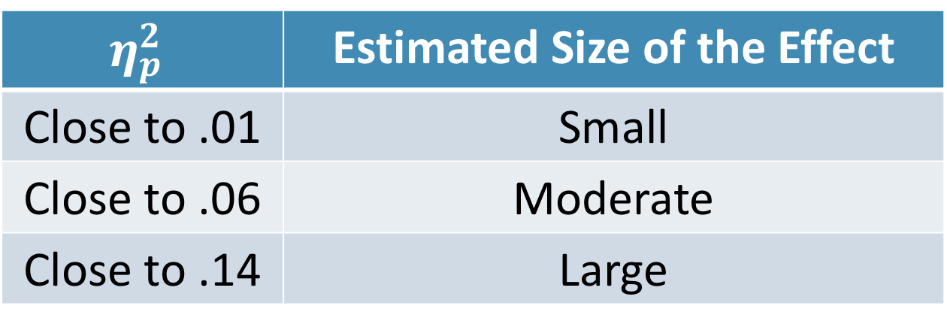
Compute an Effect Size and Describe it
5
One of the main effect sizes for ANOVA is “Eta Squared”
$$η_{p}^{2}=\frac{SS_{between}}{SS_{between}+SS_{residual}}$$
$$η_{p}^{2}$$ | Estimated Size of the Effect
Close to .01 | Small
Close to .06 | Moderate
Close to .14 | Large
Notes:
Can also use Cohen’s d here as well for each mean difference

Slide 38
Interpreting the results
6
Put your results into words
Use the example around page 382 as a template

Slide 39
Let’s use
Jamovi
One-Way ANOVA

Slide 40
Break Time

Slide 41
Review!

Slide 42
Questions?

Slide 43
Next week:
Mid-Term Exam

